Slide 1
Trajectories and treatments for patients living with vascular dementia
Fergus Doubal

Slide 2
Disclosures
Salary from NHS Lothian, University of Edinburgh and Scottish Government
Government/charity research grant funding trials/studies
Author ESO and AHA guidelines in SVD management
No commercial links

Slide 3
Outline
An approach to dementia (Small vessel disease)
Trajectories of post stroke cognition
Novel treatments – LACI stable of trials
Novel approaches - advanced brain MRI and NLP

Slide 4
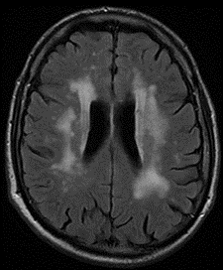
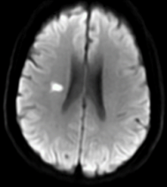
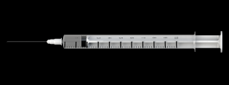
An approach to dementia
Definitions vary
DSM V
Major cognitive
disorder
Pragmatic
Post stroke
Small vessel
disease
Alzheimer’s Disease
Vascular disease

Slide 5
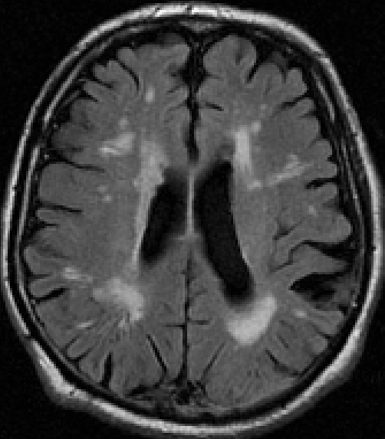
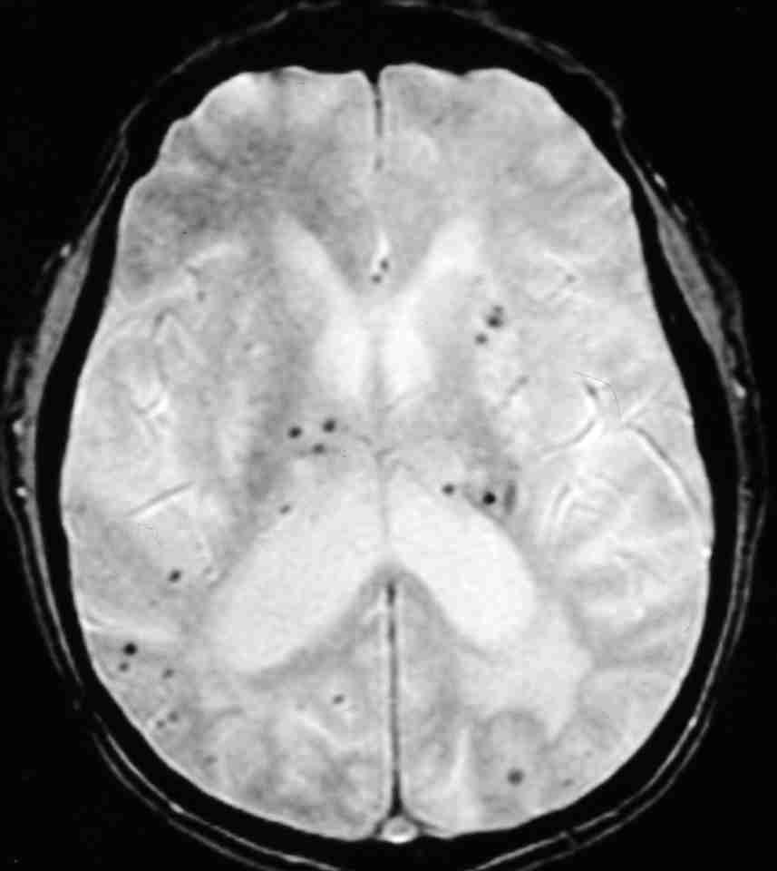
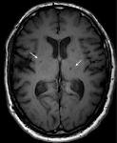
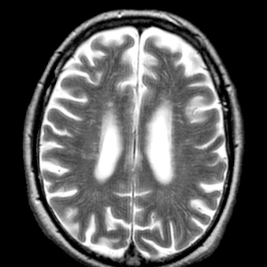
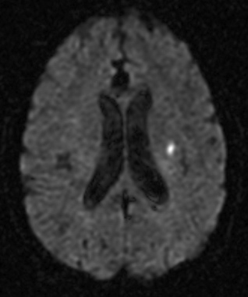
Cerebral small vessel disease is seen on brain scans and causes stroke and dementia.
White matter hyperintensities
Microbleeds
Lacunes
Enlarged perivascular space
Recent small subcortical
infarct
Doubles risk of stroke, dementia and death.
Exact pathophysiology unknown
No specific treatments
SVD and stroke main drivers of vascular dementia
Debette et al JAMA Neurol 2019;76:81

Slide 6
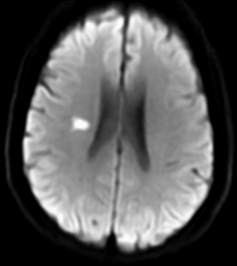
Trajectories of post stroke cognitive function hitherto unknown
Baseline stroke Week 6 Year 1 Year 2
N=2441
UK wide – 52 centres

Slide 7
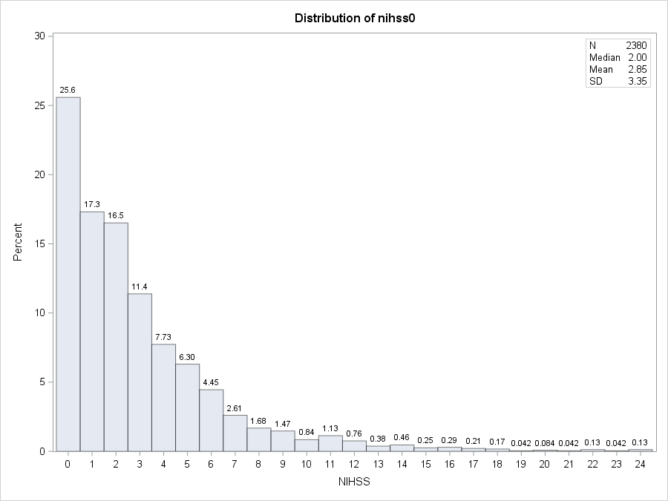
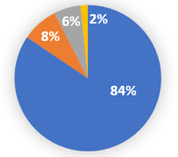
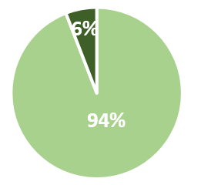
Results: Baseline data
Baseline NIHSS
Age : M= 68.2 (SD 13.5) Range 19-97
Median 5 [3-13] days after stroke
Sex
Stroke subtype
Capacity to consent
TIA
ICH
Spread of stroke severities but mainly mild
40%
60%
Standard vascular risk factors
IS
Yes
Comparable with UK National Stroke Audit

Slide 8
DSM-5 Cog-7 outcome: up to 2 years:
MCI
dementia
normal
MCI
dementia
Difference:
(Umbrella test, Welch test),
+0.33 (0.26, 0.41),
p<0.0001
-0.08 (-0.18, 0.01),
p=0.088
-0.31 (-0.43, -0.18),
p<0.0001
2437
2436
2415
2280
2437
2436
2415
2280
(Mild)
(Mild)
Peak cognition at 6 weeks, p<0.0001
50%
100%

Slide 9
Key points from the R4VaD study
Almost half have objective cognitive impairment at baseline
Best cognition is 6-12 weeks after stroke; may reflect initial ‘stunned brain’, some initial recovery, then slow decline
Age, premorbid mRS, baseline MoCA, hypertension, most strongly predict 2-year cognitive impairment
Patient self-reported cognition worse than objective cognitive tests

Slide 10
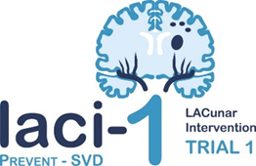
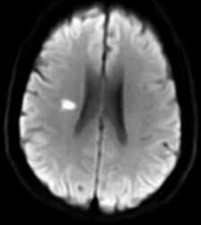
✓
Drugs tolerated well
Encouraging Brain
Imaging
Cilostazol and/or
Isosorbide mononitrate
57 patients with stroke
Edinburgh and Nottingham
Wardlaw + Bath
Blair et al eClinicalMedicine 2019:11:34

Slide 11
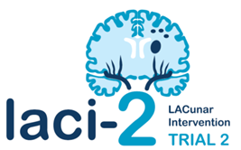
✓
Feasibility, drug adherence
Recurrent stroke/MACE
Cognitive impairment
Dependence
363 patients
with lacunar stroke
26 centres across the UK
Cilostazol
Isosorbide mononitrate
One year

Slide 12
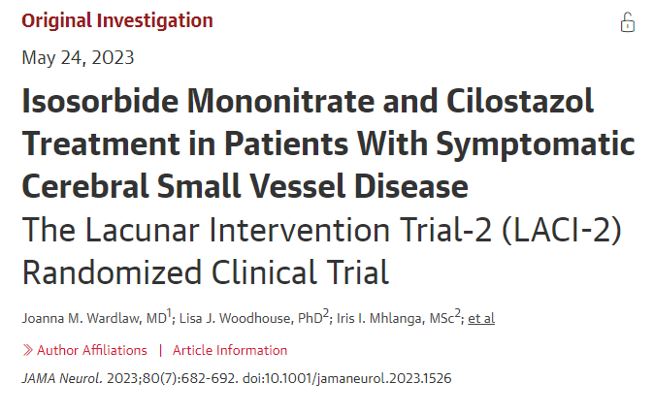
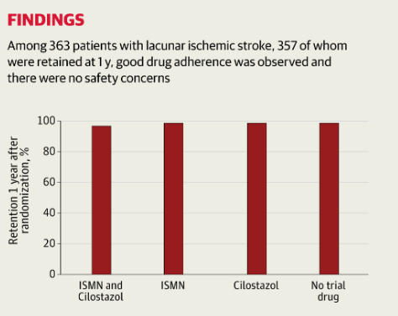
Isosorbide mononitrate reduced recurrent stroke and cognitive impairment,
Cilostazol reduced dependence,
ISMN-cilostazol reduced the composite of adverse vascular, dependence, and cognitive outcomes

Slide 13
X
3
Cognitive impairment
Function
Recurrent stroke
1300 patients
with lacunar stroke
-26 centres across the UK
Cilostazol
Isosorbide mononitrate
18 months
LACI-COG

Slide 14
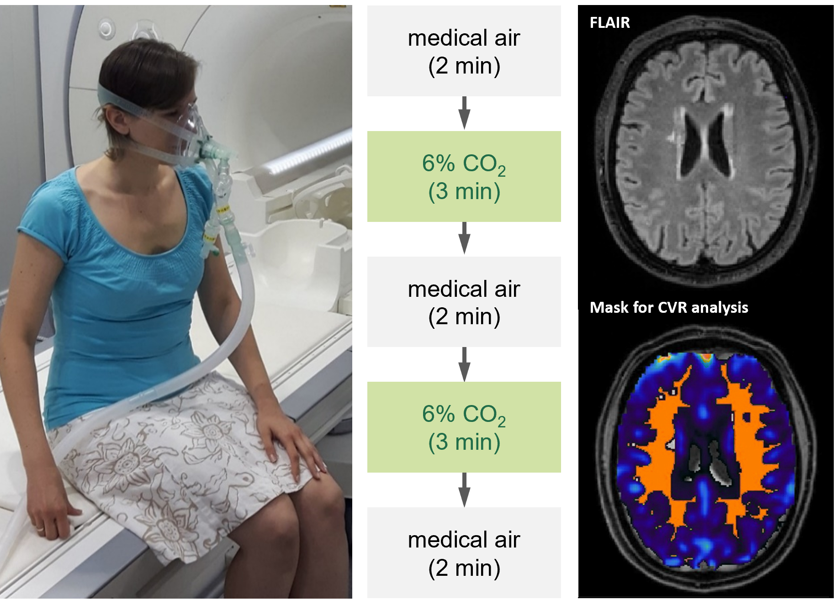
Exploiting cerebrovascular reactivity as a trial outcome measure
BOLD MRI response to a hypercapnic challenge
Normal appearing
white matter
(NAWM)
TREAT-SVDs EU Horizon 2020 funded
Kopczak et al. Eur Stroke J 2022; Blair et al. Cereb Circ Cogn Behav 2021
Slide courtesy Anna Kopczak
Notes:
The outcome measure for the primary endpoint was Cerebrovascular Reactivity as determined by BOLD MRI response to a hypercapnic challenge at the end of the washout phase and each four weeks period of drug treatment while still on medication.
CVR was measured at 3 Tesla with two blocks of breathing 6% CO₂ in medical air for 3 minutes, alternating with medical air, delivered through an anaesthesia mask.
The MRI data were processed centrally using standard operating procedures
For the primary endpoint CVR was assessed in normal appearing white matter.

Slide 15
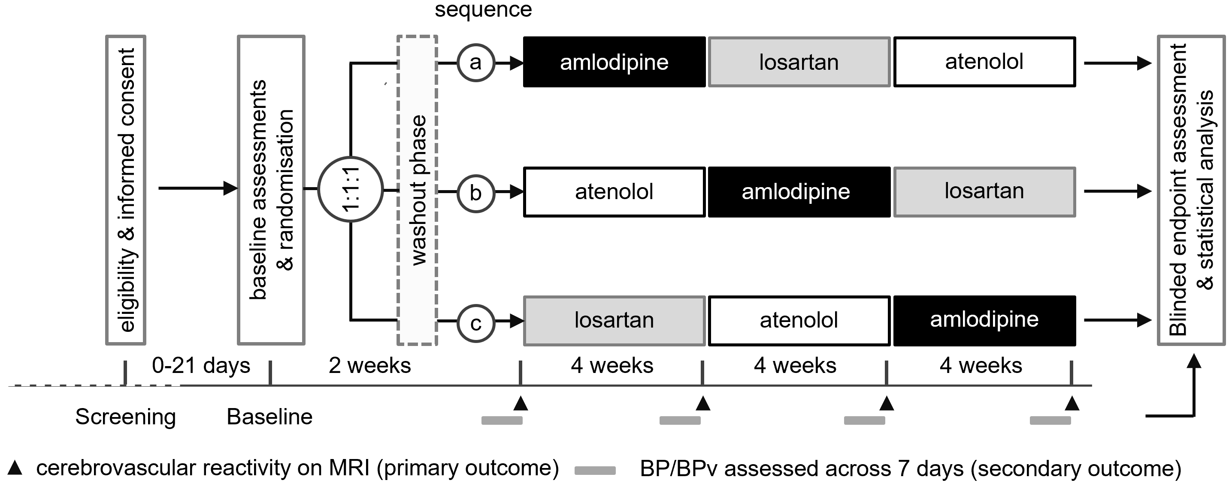
Study Design
TREAT-SVDs
N=105
Notes:
BP was assessed by daily telemetric monitoring. The BP monitoring device allowed for pulse wave analysis and the calculation of central BP.
Study physicians adjusted the dosage of study drug aiming to lower SBP to below 140 and DBP to below 90.
Switching between BP lowering agents was done without washout.
Patients returned for outpatient visits after washout and then every 4 weeks for the assessment of outcome measures and adverse events.

Slide 16
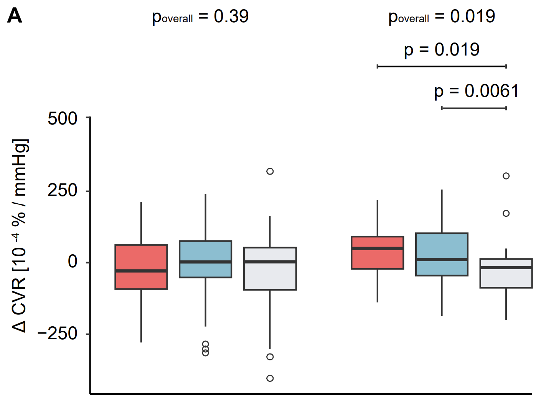
Cerebrovascular Reactivity in CADASIL patients improved with both amlodipine
and losartan compared with atenolol. No effect in Sporadic SVD.
Primary efficacy analysis
Notes:
… Change in CVR:
There was no significant difference in the treatment effects between amlodipine, losartan, and atenolol in sporadic SVD patients.
However, there was a significant treatment effect in CADASIL patients, the global p value being 0.019.
CVR in CADASIL patients improved with amlodipine compared with atenolol and with losartan compared with atenolol.

Slide 17
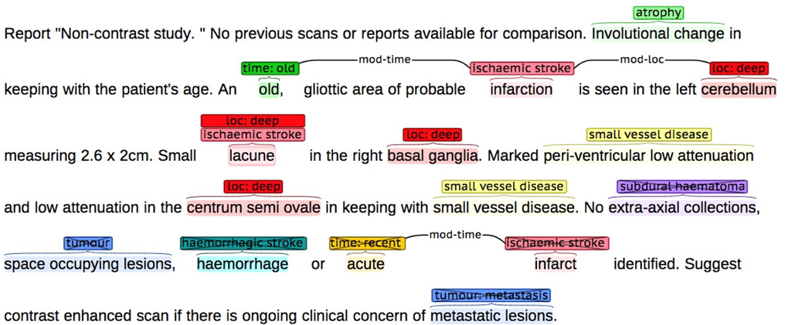
Natural language processing can identify patients to recruit for trials.
Will Whiteley and team, University of Edinburgh

Slide 18
The UNCOVER trial.
Use natural language processing to identify patients
1,069,391 scans from 651,025 people (2008-2018)
250k have SVD
Link with healthcare data to make sure covert
Invite to take part in trial – careful design of letter

Slide 19
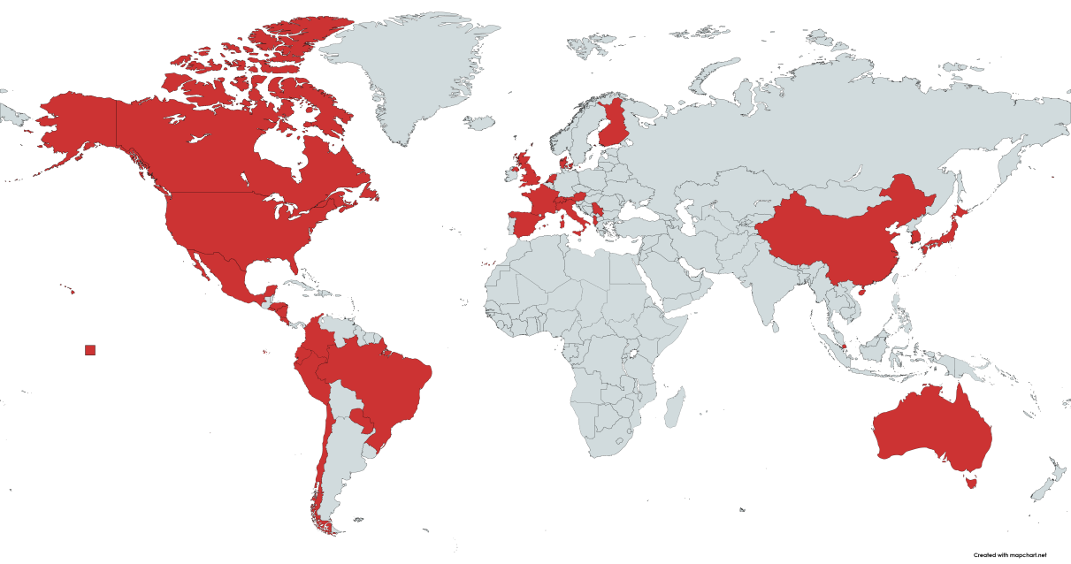
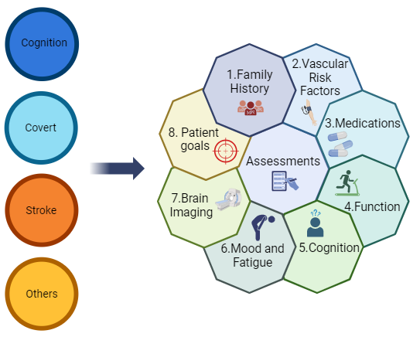
International Survey of SVD clinics in practice
Carmen Arteaga
263 invitations, 137 responses (rate=50%);
12% reported having SVD-specific services, 150 patients/year.
60 (77%) believe there is a local unmet clinical need,
137/260 Respondents from 45 countries

Slide 20
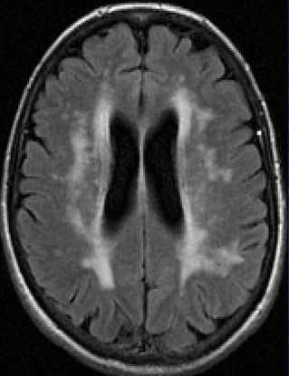
Summary
Conjoined nature
VaD and AD
Post stroke cognitive
trajectories
Novel treatments
LACI trials cilostazol/
Nitrates and approaches
Novel clinical services
Thank you

